Slide 1
CFO-B2C
AM Status - Update
Jun 17, 2019

Slide 2
Agenda
Open/ Closed Tickets - Ticket Analysis
KT Status - Primary /Secondary support
Incident handling procedures and assignment groups for OPS team
Steady state review and Ops pain points
Access issues this week, newer information security policies
Challenges - > 24 Support hours/1 Ops resource
Batch job failures
Software end of Software life – How its impacting current applications
RIRB - Update
Review Steady State Checklist - Targeted for this WEEK with Brent

Slide 3
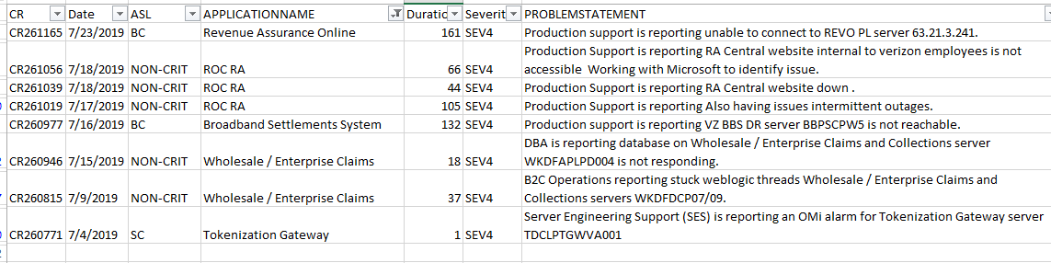
Crisis Tickets:

Slide 4
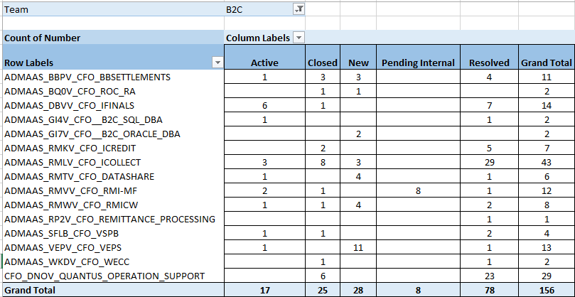
Weekly Ticket Counts (AYS)

Slide 5
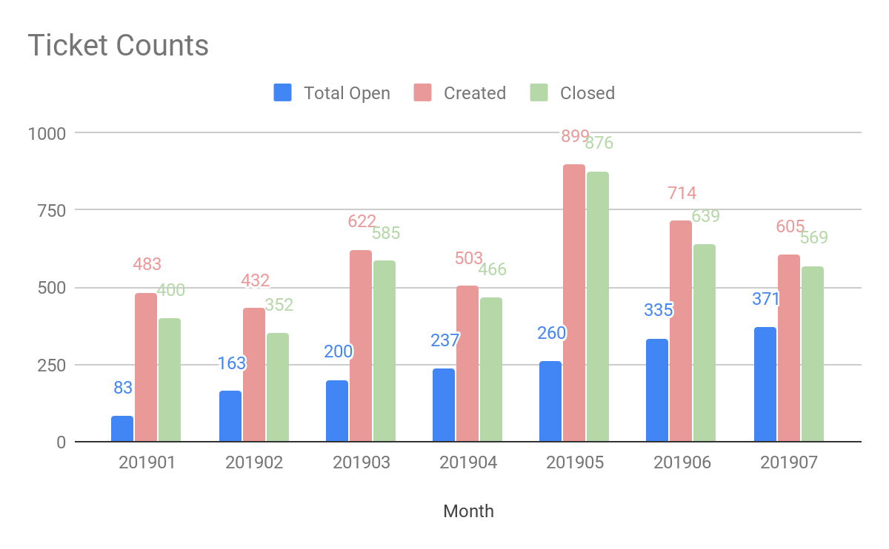
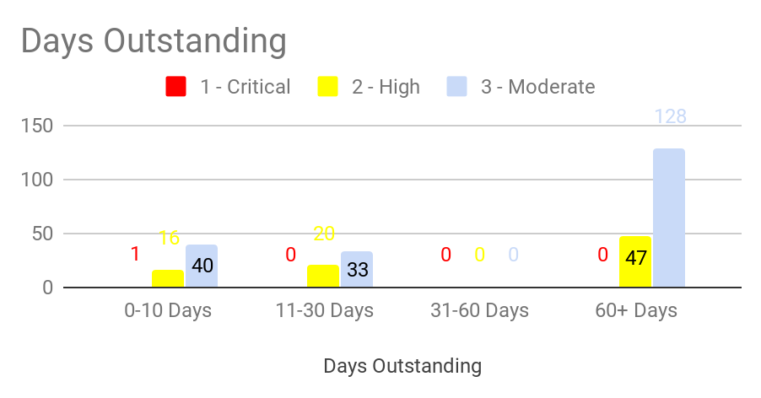
Ticket Counts (AYS)

Slide 6
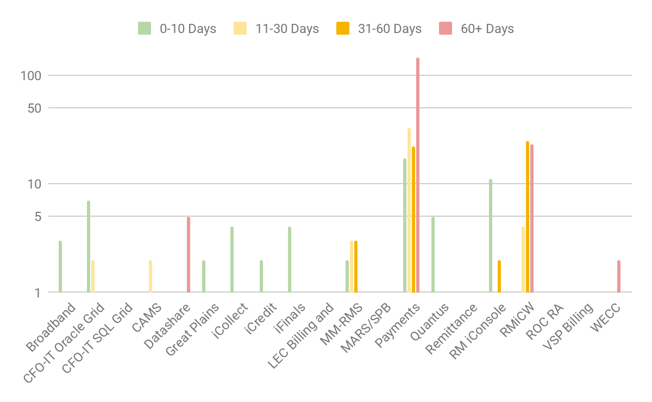
Aging by App (AYS)

Slide 7
AYS tickets - Rerouting
By default most of tickets are getting assigned to the Payment assignment group instead of the being assigned to the billing related assignment group
Babu ( Payments) - Babu and Brent scheduled to meet with Business on 7/23 to enable rerouting of tickets to the right assignment group
Iggy (RMiCW) : There are duplicates and the number may not be accurate as we have duplicate entries from Jira in AYS and needs to be cleaned up
RMiCW breakdown out of total 53, below have to be redirected to right assignment grps
Optix - 31
Bill format related - 15

Slide 8
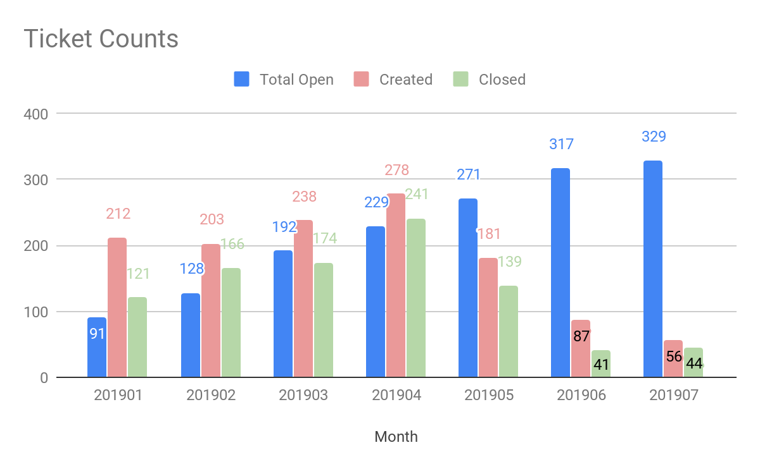
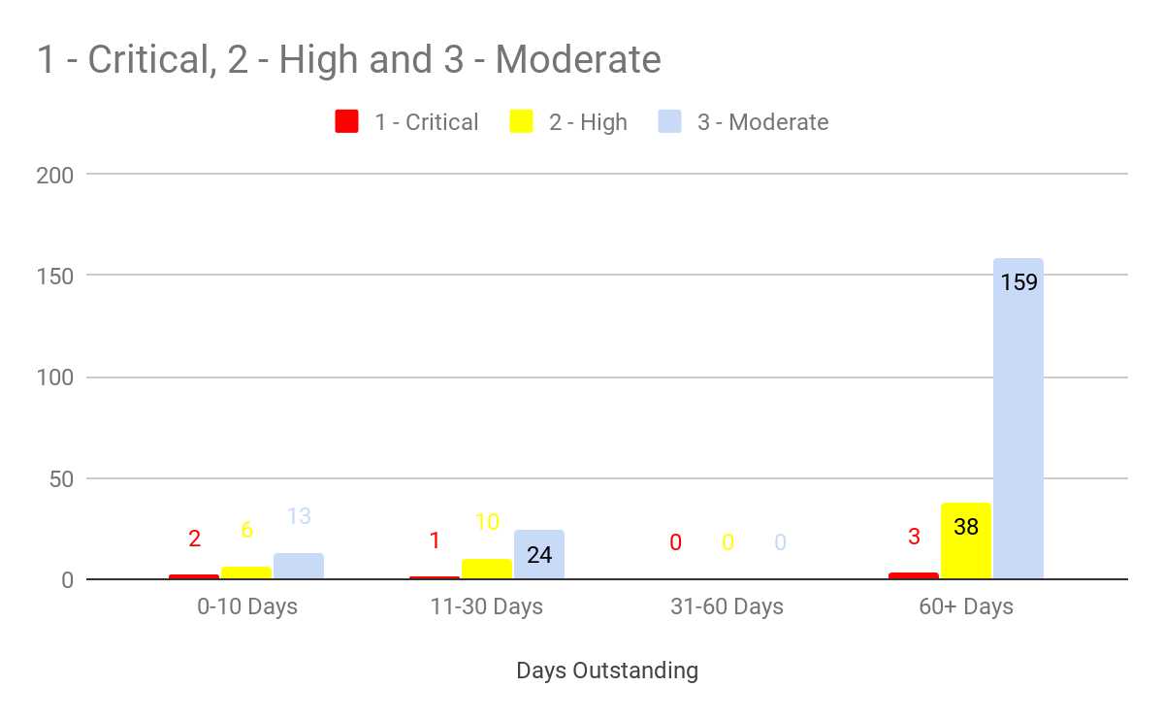
Ticket Count (JIRA)

Slide 9
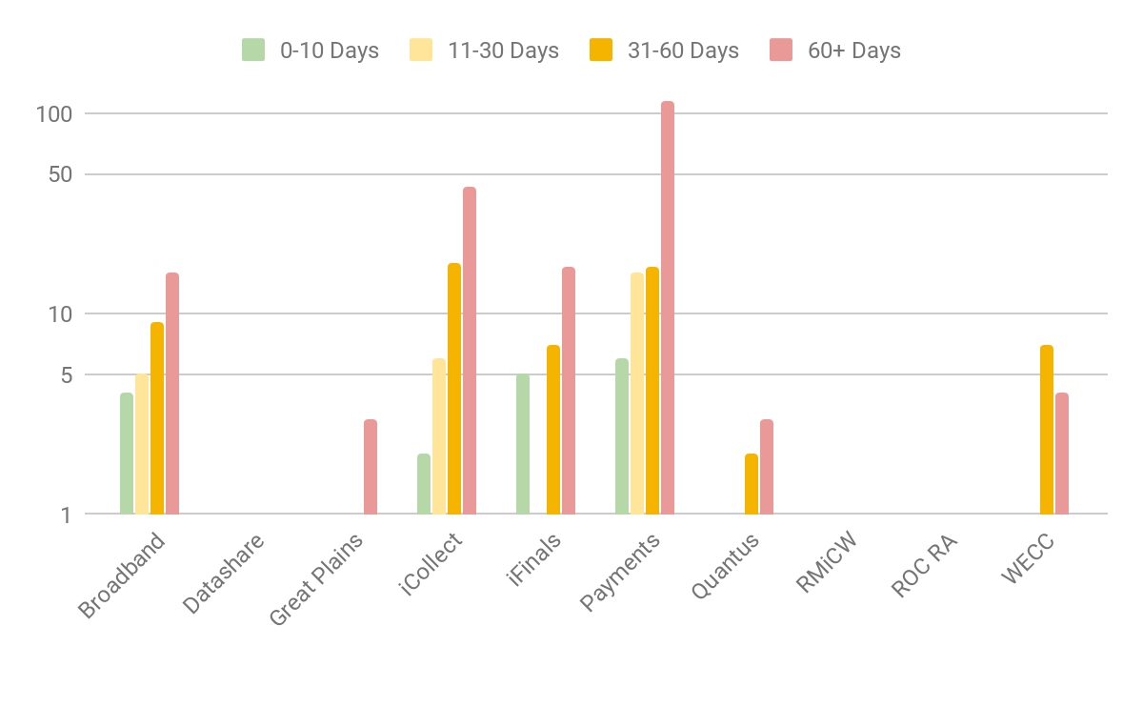
Aging by App (JIRA)
Payment team has scheduled daily meeting to review the Jira tickets and track them to resolution

Slide 10

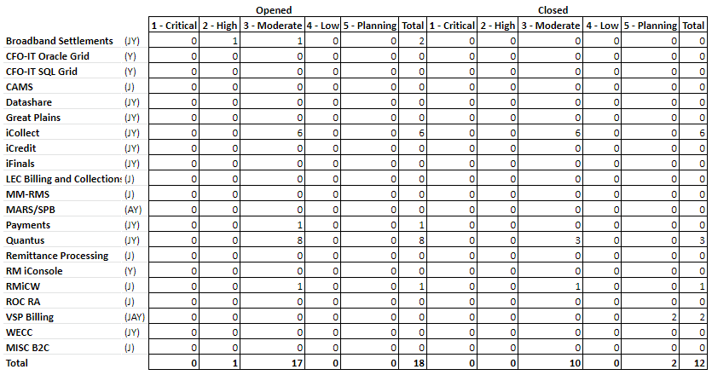
Incident Ticket Distribution - Last Week
Notes:
Last Updated : 20190717
(J) JIRA
(A) ASSIST
(Y) AYS

Slide 11
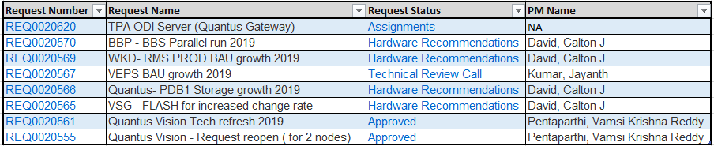
Application Maintenance - PCASE request
Below are few recent PCASE requests that are in WORK IN PROGRESS - follow up calls scheduled
Notes:
Last Updated : 20190717

Slide 12
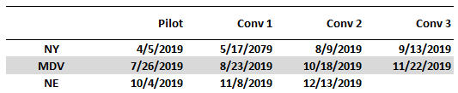
IRB
Upcoming Dates :
First MDV date pushed from 7/12 ⇒ 7/26
Revised RIRB dates now have MDV starting before NY completes. Team needs to be conscious of hard-coded region values as we switch the region we are actively converting.

Slide 13
Knowledge Transfer : Status
Remittance Processing:
Reverse KT from Sujith on 7/9 and 7/10 and AID document submitted for review
iFinals:- Primary Support in progress.
Spandana in Primary support and Kibere tentative date to be back is Mid July
RMiCW:
Mekebib Gezahegn replaces Leena for RMiCW application
Mekebib Gezahegn working on his access issues with Vz helpdesk
Settlements:
Reverse KT from Imtiyaz completed on 7/16 and Reverse KT scored obtained
USWIN id access pending and on the follow up item list
VEPS
Padma Yarabham Reverse KT completed, start secondary support role 7/5.

Slide 14
Application Maintenance - Incident Management
Review the incident management procedures and compliance
To streamline operations, Below are a few procedures agreed to comply
Ideally, an Incident would be logged in the ticketing system namely AYS by Business or IT group
OPS members will be assigned to the respective application specific assignment groups in AYS
Each OPS team will be monitoring the below Assignment groups, namely
ADMAAS_$Application_Name
CFO_ $Application_Name
The incident manager on the Assignment group will either assign the ticket within the group or reassign them to other groups this way ensures no ticket remains unassigned.
Any planned activities with IT/ business that needs desk time of Ops team is best to occur during regular business hours. But the Ops team is available for resolving incident tickets as specified by the SLA’s

Slide 15
Application Maintenance – Steady state checklist review
Will be scheduling steady state checklist review meetings with Brent/ Verizon SME and Ops team
Calling out a few pain points / Impact to OPS
Frequent changes in the Verizon info security access policies -> Impacts, timely address of real time operation issues
List of application have EOSL -> A concern as we are discussing a steady state, additional capacity to be factored
More than frequent batch job failures and types of failures -> Need for a OPS staffing plan to be more sustainable also offshore does not have access to production
Repetitive nature of batch job failures -> Can there we some control in place at source, Intelligence added to processing this data in transit or at target
Currently few B2C applications lack a few industry best practices namely, Lack of pre prod stage environment, configuration management , manual deployment, regression testing , proper test data in non prod -> Needs a collaborative effort between Verizon and Ops team to overcome these

Slide 16
Application Maintenance – Changes in access with “No Notification”
On June 12th after 5PM, The Infosys team OPS member were not able to login to VZ network.
On contacting helpdesk, Infosys Ops team was informed that (effect June 12th onwards), changes have been made such that contractors will have go via the EBP route to access Verizon network.
This access change in access was not communicated to Infosys
that night, Infosys team had to spend late evening hours in trying to resolve this with Verizon helpdesk
Below are the EBP url’s the team had to use to access the Verizon network.
City | URL
Freehold, NJ EBP | https://fhebpsslvpn.verizon.com/pulse
Sacramento, CA EBP | https://sacebpsslvpn.verizon.com/pulse
Tampa, FL EBP | https://tpaebpsslvpn.verizon.com/pulse
While troubleshooting issues, team’s on the call are unable to share or view screen shots thru Jabber
Again on June 15^{th (Saturday)},
A recent Verizon security change, Onshore OPS can no longer deploy ODI scenarios outside of the office
Ops team had to go into the office to deploy the code over the weekend

Slide 17
Application-wise - Operation team Primary and Support Coverage -> Challenges
Application | Primary | Support coverage | Tasks
iFinals | Spandana Chamala | 24 hours (Day / after hours for batch job failures) | Batch job support (Night) code deployments ( Night) Adhoc request from business /Dev/ IT (Day)
RMiCW | Leena Sawhney/ ** Mekebib | 24 hours (Day/ after hours for batch job failures) | Batch job support ( Night) code deployments ( Night) Adhoc request from business /Dev/ IT ( Day)
iCollect | Lakshmi Buddi | 24 hours (Day/ after hours for batch job failures) | Batch job support (Night) code deployments (Night) Adhoc request from business /Dev/ IT (Day)
Remittance Processing | Kenneth /Michael/Sujith | Extended business hours (7 AM- 7 PM) | Assigned to multiple locations to support operations

Slide 18
Application Maintenance – Batch job failures
File related issues:
There are numerous file transfers and files not sent on time or not collected
The data within the file missing mandatory column
The data files with duplicate rows and ops team needs to remove duplicates
The files are corrupted f(unable to open/ Not readable)
The file transfers Ftp Job failure intermittent due to network issues
Encounter typical system resource related issues
Lack of disk space
Lack of memory issues, swap space for the application
Size of database log and table space → Increased monitoring and adjusted the Threshold limit
Issues in Payments Area
Files did not go out to External system, no alerts.
Duplicate payments
Payment not processed
Payment not sent to settlement, VOD system not sending shipment complete.

Slide 19
Application Maintenance - Risks with EOSL – End of software life
Few risks with using End of Service Life (EOSL) software
Lack of vendor support
Will not receive the new security patches
Compatibility with latest hardware /infrastructure and 3rd party products will be impacted
Will not be able to upgrade to the latest updates on new enhancements or features of the product
End of Software life) : As a practice generally set a minimum of 18 months prior to the official vendor EOSL to ensure ample time to remediate
And also “No” new deployments should be done on EOSL software

Slide 20
Application Maintenance – Issues with EOLS (End of Software life)
RMS Performance issues on 6/13: Need additional nodes to handle the traffic bandwidth
The RMS system is on unsupported WebLogic 10.3 running on an older version of Linux (ver. 5.3)
We are unable to add additional server nodes because of both app server and OS
WebLogic is on a unsupported version ver. 10.3
Inability to procure the older Linux version 5.3
Tweaking WebLogic setting for performance (Risk):
Due to the unsupported version of WebLogic, any additional changes to current settings to enhance performance can cause unexpected results
Workaround: The current workaround is for the Ops team to proactively monitor the servers status and perform restart the weblogic instances whenever required
Notes:
Last Updated : 20190611

Slide 21
Application Maintenance – Steady state challenges
Applications | Lack of Pre Prod (Stage) Environment | Availability of a clean testing environment to drop and recreate db scripts | Regression test suite to test existing functionality | Sufficient data in Non Prod - unable to test | End of Life for Hardware / Software | Lack of Documentation ( Run book) | Lack of source code repository/ Configuration mgmt. including DB | Using manual deployments instead of scripts
iCollect | x |  |  | x | x | x | X | X
iFinals | x |  |  | x | x | x | X | X
RMiCW | x |  |  | x | x | x | X | X
Remittance Processing |  |  |  |  | X | X | X | X
WECC |  |  |  |  | X | X |  | X
iCredit | X |  |  | X | X | X | X | X
Broadband Settlements |  |  |  | X | X |  |  | X
Great Plains | X |  | X | X | X | X |  | X
ROC RA |  |  |  |  |  |  | X | X
Payments (VEPS) |  |  |  | X | X | X |  | X
Datashare | X | X |  | X |  | X | X | x

Slide 22
Application Maintenance – Steady state discussion
Summary:
Improve communication on Verizon info security access changes
Action plan on EOSL End of support for steady state discussion
Plan on improvement on the batch job failures and show these can be mitigated
Have a more sustainable Ops staffing plan
Review the best practices on how we can implement the best practices to have a steady state on applications

